Slide 1
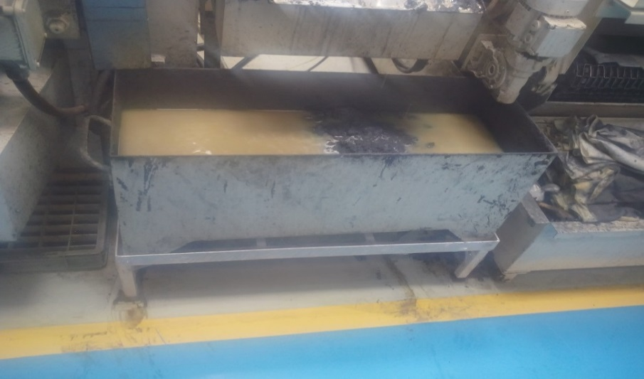
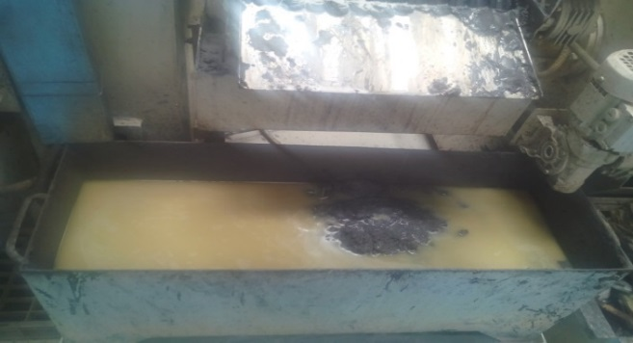
P15
KAIZEN NO :- 13
ACTIVITY
KK
QM
PM
JH
SHE
OT
DM
E&T
KAIZEN IDEA SHEET
TPM CIRCLE NAME:
LOSS NO. / STEP
DEPT :- MACHINE SHOP
RESULT AREA
P
Q
A,B,C
C
D
S
M
CELL:- Grinding
CELL NAME:- A225 Gear
MACHINE / STAGE :- Microsmatic Grinding
OPERATION :- O.D Grinding.
KAIZEN THEME : To Eliminate coolant spread.
IDEA :- Tank Height to be Modified.
Problem / Present Status :-
In Cylindrical Grinding Machine floor get dirty due to Grinding Slush spread on floor.
COUNTERMEASURE:- Tank height modified by providing stand.
BENCHMARK
Slush on Floor
TARGET
Floor should be clean
KAIZEN START
18.04.2016
TDC
29.04.2016
KAIZEN FINISH
TEAM MEMBERS : 1.Dinesh Kakad, Sandip Jagtap, Navnath
BENEFITS :-
1 Hose keeping Improve.
After
KAIZEN SUSTENANCE
WHY - WHY ANALYSIS :-
Why1 :- Cylindrical Grinding Machine floor becomes dirty .
Why2:- Coolant Spread on floor during slush dropping.
Why3 :- Distance between Coolant tank slush separator is more .
Why4 :- Height of Coolant tank is less.
RESULT :-
Grinding Slush spillage Avoided.
House Keeping Improve.
WHAT TO DO:- Use only Modified Tank
HOW TO DO:- N.A
ROOT CAUSE :- Height of Coolant tank is less.
REGISTRATION NO. & DATE : 29.04.2016
SCOPE & PLAN FOR HORIZONTAL DEPLOYMENT
REGISTERED BY :- Sandip Jagtap
SR.
NO.
CELL
TARGET
RESPONSIBILITY
STATUS
MANAGER’S SIGN :- D. Y. Pawar
1
---
------
-----
----

